Slide 1

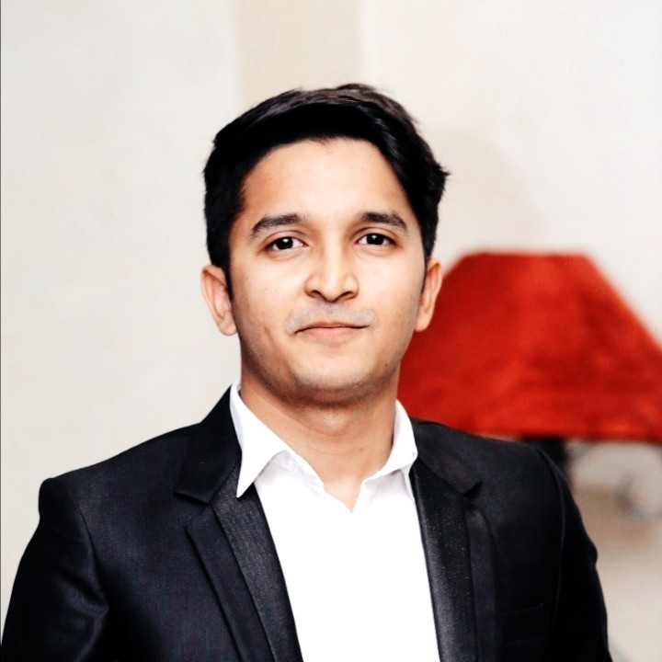
Syed Mouaaz Farrukh
linkedin.com/in/syed-mouaaz-farrukh/
Cloud Engineer @ Avanceon
Founder @ DevWithOps
Certified @ Azure –AWS

Slide 2
Day – 02: Cloud Odyssey
Get started with
Cloud Solutions

Slide 3



Free Tier
Cloud
Services
AWS - https://aws.amazon.com/free/
Azure - https://azure.microsoft.com/en-us/free/search/
GCP - https://cloud.google.com/free/

Slide 4




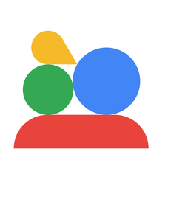

Working
with
Cloud
via
CLI
via CONSOLE
via
SDK

Slide 5



Major Cloud
Compute
Services
Storage
Database

Slide 6




Major Cloud Services
Compute
COMPUTE
Storage
Database
AzureVirtual Machine
GCP Compute Enginer
AWS
EC2
Serverless/IoT

Slide 7

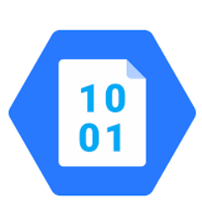

Compute
Major Cloud Services
Storage
Storage
Database
AzureBlob Storage
GCP Cloud Storage
AWS
S3 Bucket
Serverless/IoT

Slide 8
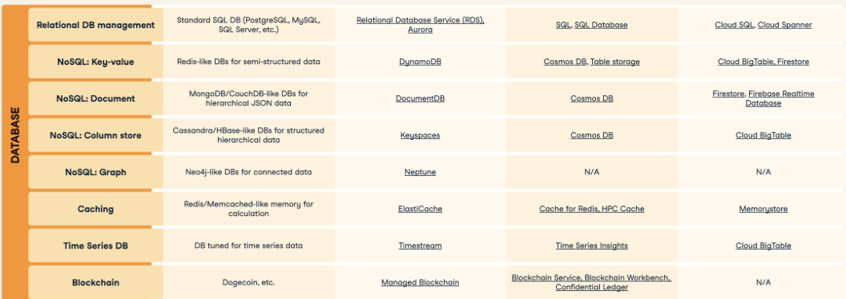
Database
Major Cloud Services
Compute
Database
Storage
Serverless/IoT

Slide 9
NEXT UP IN THE SERIES
Designing Cloud
Solutions

Slide 10
THANK YOU

